Slide 1
LeetCode for Beginners :)

Slide 2
Announcements
Let us know if you’d like to be a buddy for incoming freshman in March!
FORMAL TMRW!!!!!!!

Slide 3
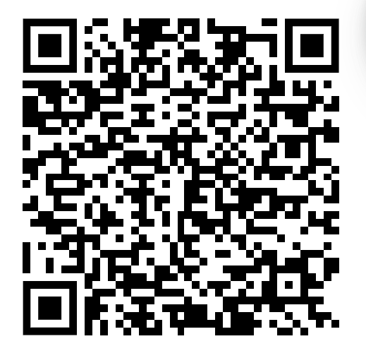
Feedback Form
Events done thus far:
Imposter Syndrome Talk
Linkedin Workshop
Resume Reviews with Honeywell
Exploring Fields in CS
Game Night
Mock Interviews
Spill the Tea
Intro to APIs

Slide 4
Slays of the Week
Kiana finished data logging a day early!!! Slay Kiana!!!
Anita started her lab early for the first time in months
Nikhita got her first internship offer!!!! SLay Nikhita!

Slide 5
Anti Slays of the Week
Kiana cut her hand open with a pencil
Madeline cannot hear

